Slide 1


Contents
About Brazilian Patient Groups
33 Brazilian patient groups describe their roles in Brazil’s healthcare system.
They detail the challenges facing Brazilian patient groups, and point to the support they need to complete their goals.
Source: Brazil-specific findings from the October 2024 PatientView report, ‘Patients in Action’.
About Pharma Partnerships in Brazil
121 Brazilian patient groups describe what they think of pharma.
They identify the strategic interventions they wish pharma to implement in Brazil, to improve
patient-group relations.
Source: Brazil-specific findings from the most-recent edition (that of 2023/24) of PatientView’s annual report, ‘The Corporate Reputation of Pharma—from a Patient Perspective’.
The Patient Movement in Numbers
—a Focus on Brazil
October 2024

Slide 2

2
Introduction: PatientView
PatientView is a research, publishing, and consultancy group, created out of a belief that the views of patients should be considered in all important healthcare decisions.
PatientView has an extensive reach of 40,000 patient groups worldwide (drawn from across most therapy areas, and from almost every country).
PatientView amplifies the powerful voice of patient groups, and works to ensure that their insights are heard by the pharmaceutical industry, and by other major healthcare stakeholders—all with the aim of enacting meaningful, positive change.
Patient groups possess a unique understanding of the needs of patients, and represent the collated voice of patients.
Patient groups have taken on an increasingly significant role in healthcare—from policy and advocacy, through to the direct provision of services to patients.
Despite having a growing influence on the shaping of healthcare, patient groups are often misunderstood
—seen primarily as patient-support networks, rather than as key contributors to healthcare decision-making and advocacy.

Slide 3

4
About the 2024
‘Patients in Action’ data
About Brazilian Patient Groups
Brazil-specific findings from the
October 2024 PatientView report, ‘Patients in Action’.
33 Brazilian patient groups describe their roles in Brazil’s healthcare system.
They detail the challenges facing them, and point to the support they need to complete their goals.
PatientView’s research in ‘Patients in Action’ has the following aims:
Determine the roles that patient groups hold within healthcare systems.
Understand how patient groups believe they are perceived by other healthcare stakeholders.
Map the activities of patient groups.
Discover the types of support that patient groups need to receive, if they are to fulfil their goals, and improve patient outcomes.

Slide 4
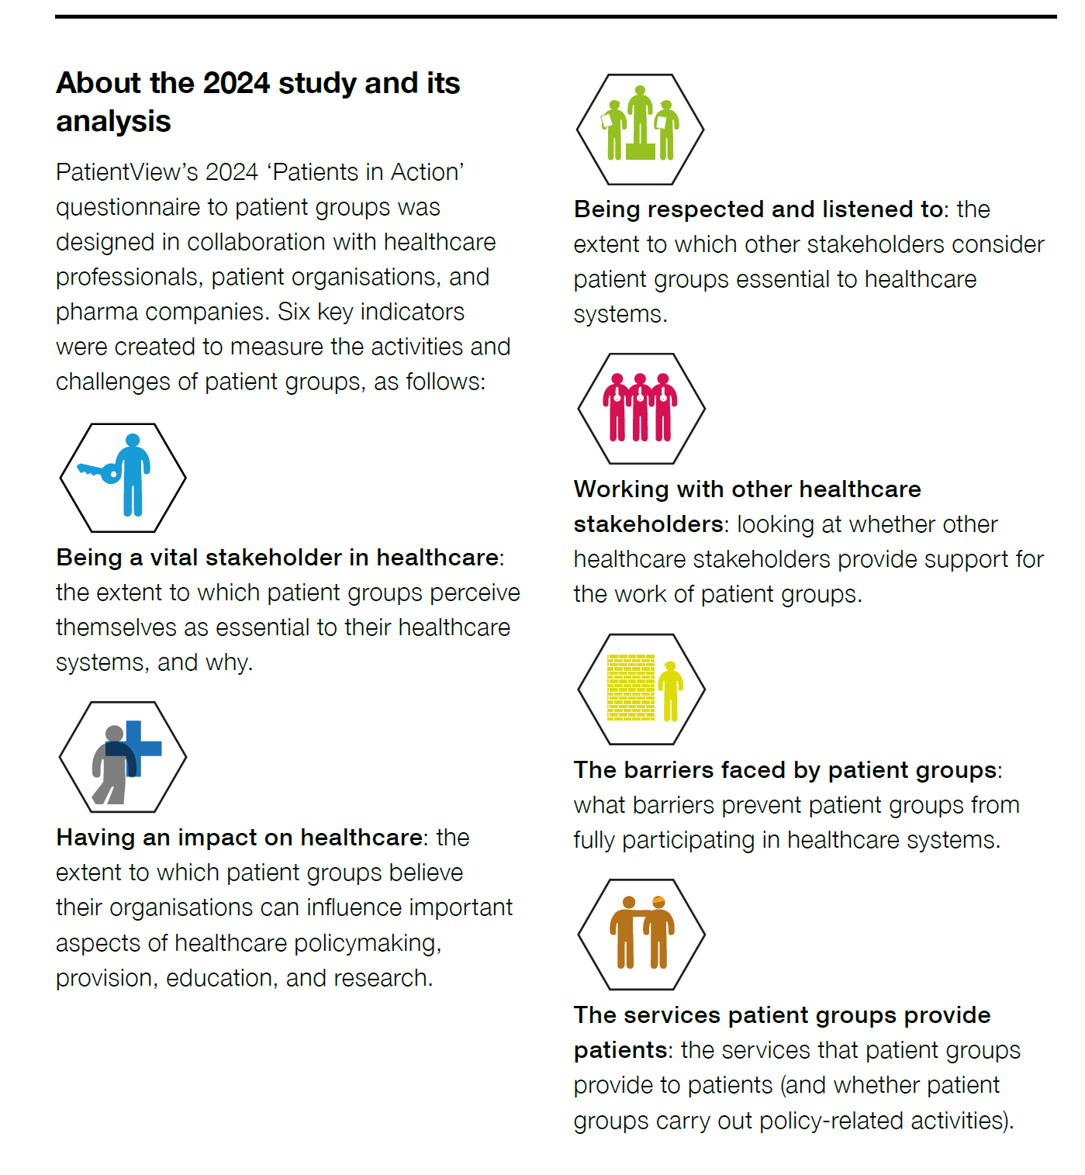
6
Methodology behind ‘Patients in Action’
A ‘Patients in Action’ questionnaire, aimed at patient groups, was designed by PatientView, in collaboration with healthcare professionals, patient groups, and pharma companies.
This ‘Patients in Action’ questionnaire was run, June to August 2024.
The survey attracted responses from 1,144 patient groups (drawn from 83 countries, and from 65 broad specialties).
33 patient groups from Brazil responded to ‘Patients in Action’.
These 33 Brazilian patient groups estimated that they were in contact with (and represented the interests of) approximately 300,000 Brazilian patients during 2024.

Slide 5
8
Executive Summary:
‘Patients in Action’, Brazil
Patient groups from Brazil are the most likely
(out of patient groups from the 19 countries analysed in ‘Patients in Action’) to consider themselves essential healthcare stakeholders in their country.
Patient groups from Brazil consider themselves the most influential (out of patient groups from the 19 countries examined in details) in providing patient information, patient education, and education for healthcare practitioners in their country.
However, patient groups from Brazil also feel themselves the least influential among the
19 countries on drug reimbursement in their country.
Brazilian patient groups provide more telephone services to patients, and support for patients in economic hardship, than patient groups in any of the 19 featured countries.
Most of the respondent patient groups from Brazil cite lack of Brazilian patient access to medicines, and lack of Brazilian patient-group funding, as
chief barriers to Brazilian patient groups’ participation in their country’s healthcare system.

Slide 6
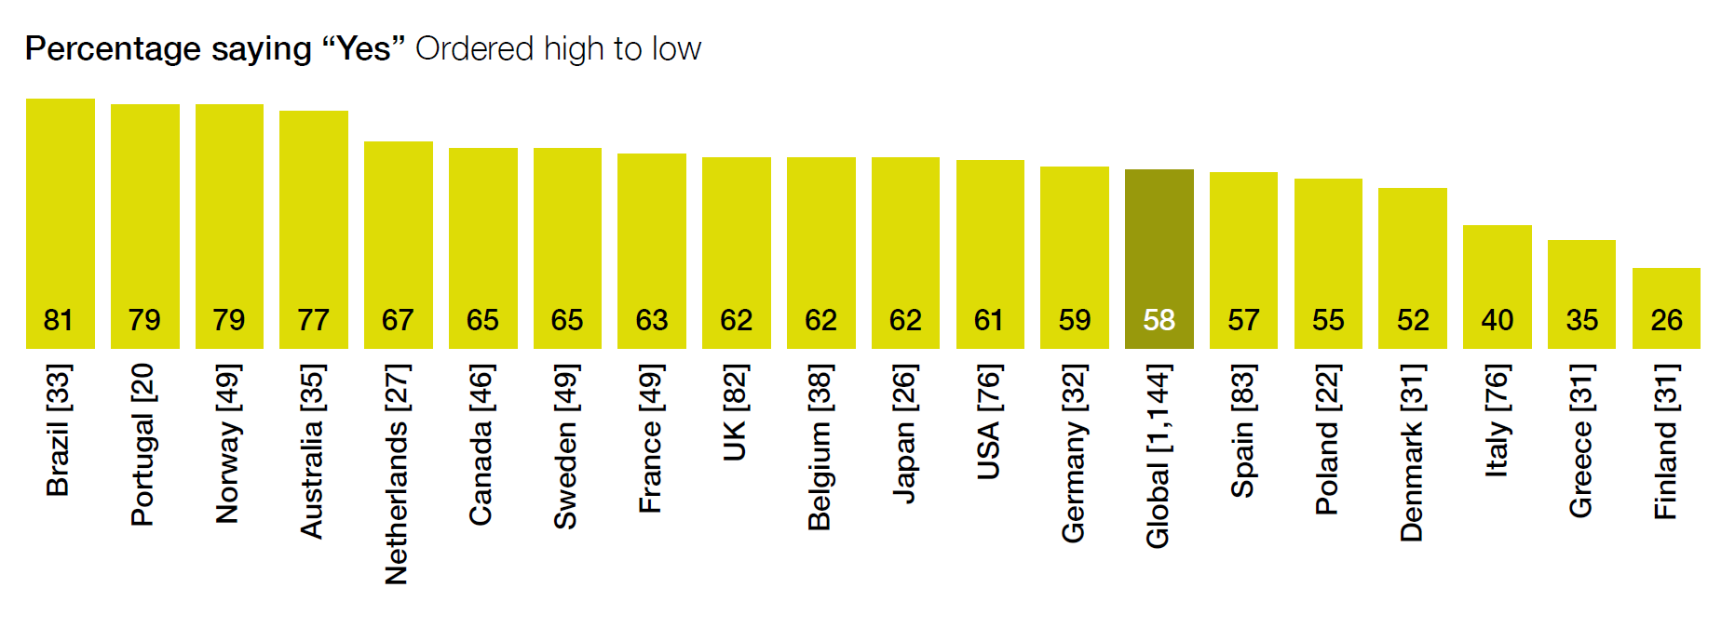
10
Being a vital stakeholder
in healthcare
Brazilian patient groups explain why they are essential to their healthcare system
Thematic analysis of commentaries
Patient groups from Brazil are the most likely (out of patient groups from the 19 countries analysed in detail in ‘Patients in Action’) to consider themselves
essential healthcare stakeholders in their country.
Theme | % of total comments
Guiding policy development, advocacy activities | 20%
Providing healthcare | 15%
Participating in regulatory, HTA, and insurer decisions | 15%
Supporting individual patients and carers | 10%
Improving self care, and health literacy | 10%
Raising awareness of disease, and its impact | 10%
Improving access to care and treatments | 5%
Improving care pathways, guidelines, and services | 5%
Researching new treatments, and disease insights | 5%
HCP education and engagement | 5%
Involvement in research | 2%
Advocating for equitable access for treatments | 0%
Other | 0%
Guiding policy development; and
instituting advocacy activities
Establishing (and strengthening) relationships with policymakers—to gain an overall commitment to resources.
Implementing effective advocacy strategies for patient and caregiver communities, and engaging with key decisionmakers.

Slide 7







12
Services that Brazilian patient groups provide to patients
‘Patients in Action’ data show that Brazilian patient groups provide a wide range of services to the Brazilian patients with whom they are familiar.
Rankings for Brazilian patient groups (out of patient groups from 19 countries) for the following elements of service provision to patients:
1st for provision of telephone services to patients in their country.
1st for supporting patients in economic hardship in their country.
4th for delivering care and treatment to patients in their country.
91%
host telephone helplines
73%
arrange peer-to-peer support groups
72%
support patients in economic hardship
68%
offer healthcare advice
52%
deliver treatment
and care
31%
support drug-treatment clinical trials
34%
undertake healthcare research

Slide 8
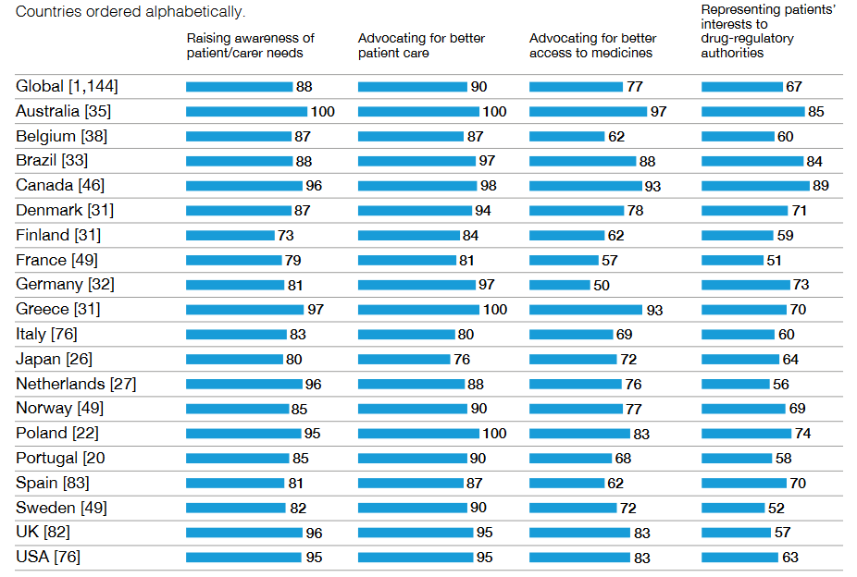
14
Policy / advocacy activities
of Brazilian patient groups
% respondents choosing option
‘Patients in Action’ data show that Brazilian patient groups engage in many policy and advocacy activities aimed at furthering the interests of Brazilian patients.
Rankings for Brazilian patient groups (out of patient groups from 19 countries) for the following policy and advocacy activities:
3rd for representing patients’ interests to regulatory authorities in their country.
4th for advocating for better patient access to treatments in their country.
4th for advocating for better patient care in their country.

Slide 9
16
Brazilian patient groups’ influence on healthcare policymaking
The percentage of Brazilian patient groups which think that they influence the following aspects of Brazilian healthcare policymaking:
71% feel able to influence the
drug-approvals process in Brazil.
64% feel able to influence Brazilian
government healthcare policymaking.
44% feel able to influence
drug reimbursement in Brazil.
Rankings for Brazilian patient groups
(out of patient groups from 19 countries)
for influence upon the following elements of healthcare policymaking:
3rd for influencing their country’s
drug approvals.
5th for influencing their country’s
government healthcare policymaking.
11th for influencing their country’s
drug reimbursement.

Slide 10
18
Brazilian patient groups’ influence
on healthcare policymaking
Do you influence drug approvals?
Percentage of respondent Brazilian patient groups
Do you influence government
healthcare policymaking?
Do you influence drug reimbursement?

Slide 11
20
Brazilian patient groups’ influence
on healthcare provision
The percentage of Brazilian patient groups which think that they influence healthcare provision in Brazil:
85% feel that they influence
patients’ access to medicines in Brazil.
64% feel that they influence
healthcare provision in Brazil.
Rankings for Brazilian patient groups (out of patient groups from 19 countries) for influence upon healthcare provision:
1st for influencing patient access to medicines in their country.
16th for influencing healthcare provision in their country.

Slide 12
22
Brazilian patient groups’ influence
on healthcare provision
Percentage of respondent Brazilian patient groups
Do you influence patients’ access to healthcare?
Do you influence healthcare provision?

Slide 13
24
Brazilian patient groups’ influence
on health education
The percentage of Brazilian patient groups which think that they influence the following aspects of health education in Brazil:
97% feel that they influence
patient information in Brazil.
91% feel that they influence
patient education in Brazil.
85% feel that they influence the
education of healthcare professionals
in Brazil.
Rankings for Brazilian patient groups (out of patient groups from 19 countries) for influence upon the following elements of health education:
= 1st (alongside Italy) for influence upon
patient information in their country.
= 10th (alongside Germany) for influence upon patient education in their country.
4th for influence upon the education of healthcare professionals in their country.

Slide 14
26
Brazilian patient groups’ influence
on health education
Do you influence patient education?
Percentage of respondent Brazilian patient groups
Do you influence patient information?
Do you influence education of healthcare professionals?

Slide 15
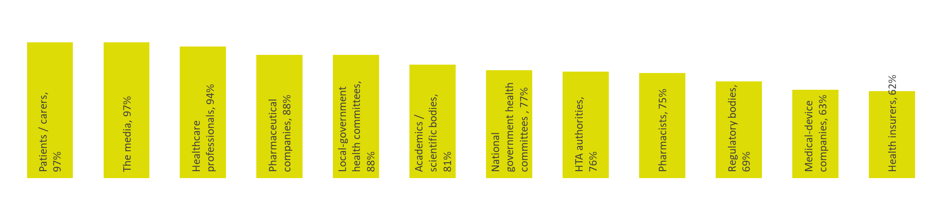
28
Being respected,
and listened to
Percentage saying “Yes” or “Sometimes”
The vast majority of Brazilian patient groups believe that they are respected, and listened to, by other healthcare stakeholders within their country (at least some of the time).
Brazilian patient groups rank 1st (out of patient groups from 19 countries) for being considered by the following healthcare stakeholders in their country as essential to the national healthcare system:
Health Technology Assessment (HTA) authorities.
Local-government healthcare committees.
The media.
Pharmacists.

Slide 16
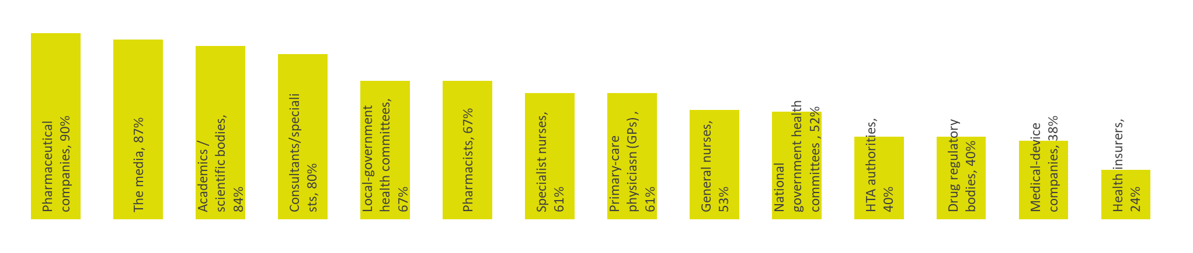
30
Working with other
healthcare stakeholders
Percentage saying “Yes” or “Sometimes”
The vast majority of Brazilian patient groups believe that they are supported by other healthcare stakeholders in their country.
Two exceptions are:
medical-device companies, and
health insurers.
Even though only 40% of Brazilian patient groups report getting support from the two types of healthcare stakeholders noted below, Brazilian patient groups rank 1st (out of patient groups from 19 countries) for receiving support from them:
Drug regulatory authorities.
Health Technology Assessment (HTA) authorities.

Slide 17
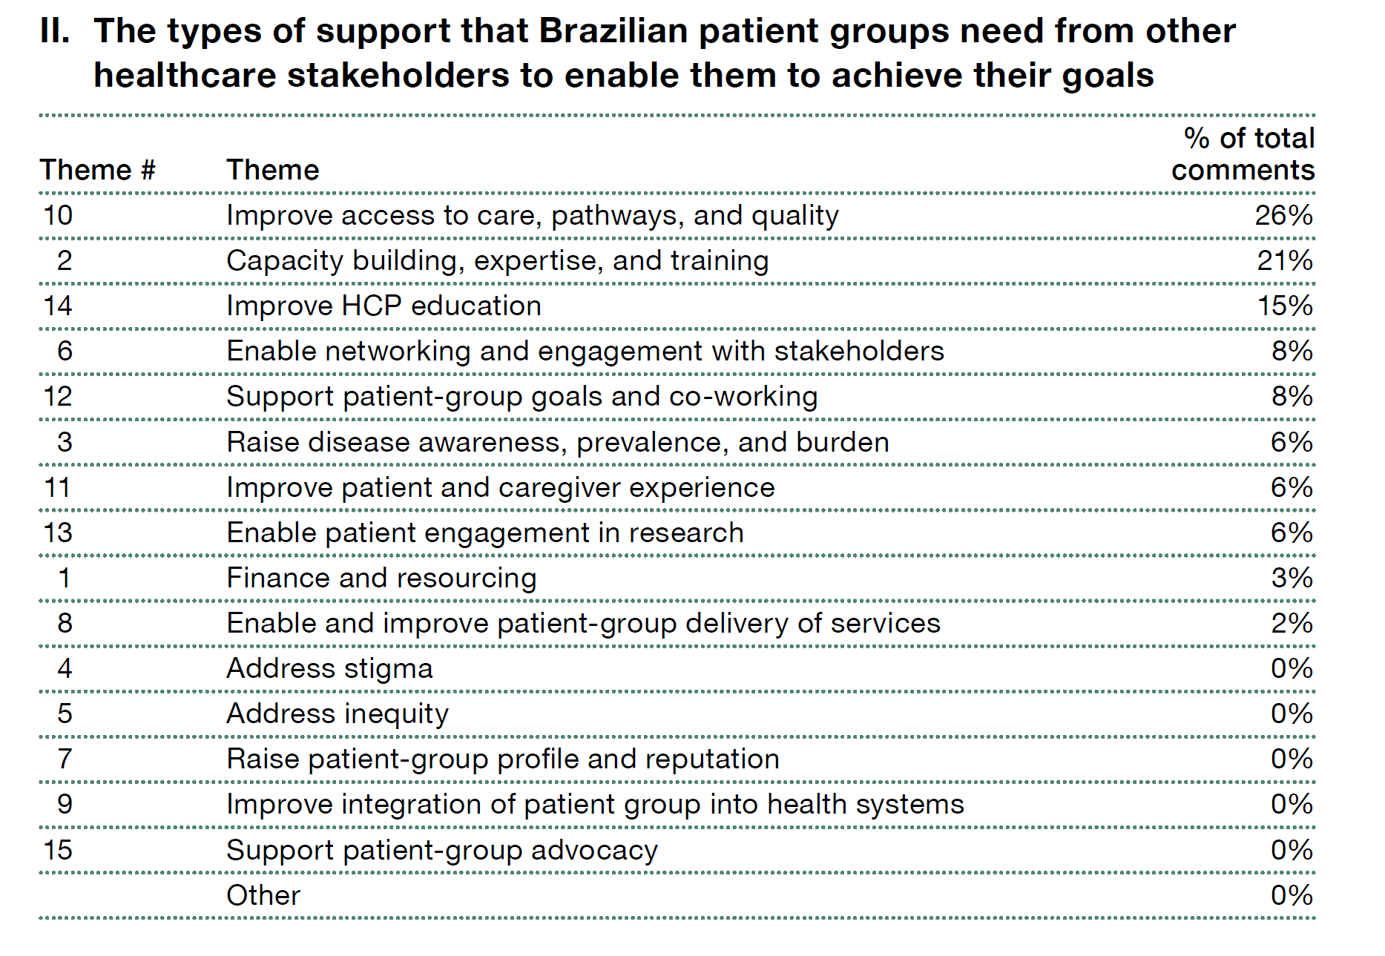
32
Support needed by Brazilian
patient groups
Brazilian patient groups provide ‘Patients in Action’ with 64 commentaries on the types of the support they require to improve patient outcomes in Brazil, and to achieve their goals.
The commentaries fall into 10 categories
—most common being a call for improvements in:
access to care, pathways, and quality.

Slide 18

34
Support needed by Brazilian
patient groups
Thematic analysis of commentaries
“Desenvolvimento de protocolos; colaboração no desenvolvimento e padronização de protocolos de atendimento e tratamento, garantindo uma abordagem consistente e eficaz.”
—National rare-disease patient group
“Atender em centros de referência específicos da doença.”
—Regional cystic-fibrosis patient group
“Equipar pelo menos 10 importantes cidades das 5 regiões brasileiras com aparelhos de função pulmonar completa (pletismógrafo).”
—National rare-disease patient group
“Parceria das secretarias Estadual e Municipal nas ações e atividades que são desenvolvidas diariamente pela instituição.”
—Local HIV/AIDS patient group

Slide 19
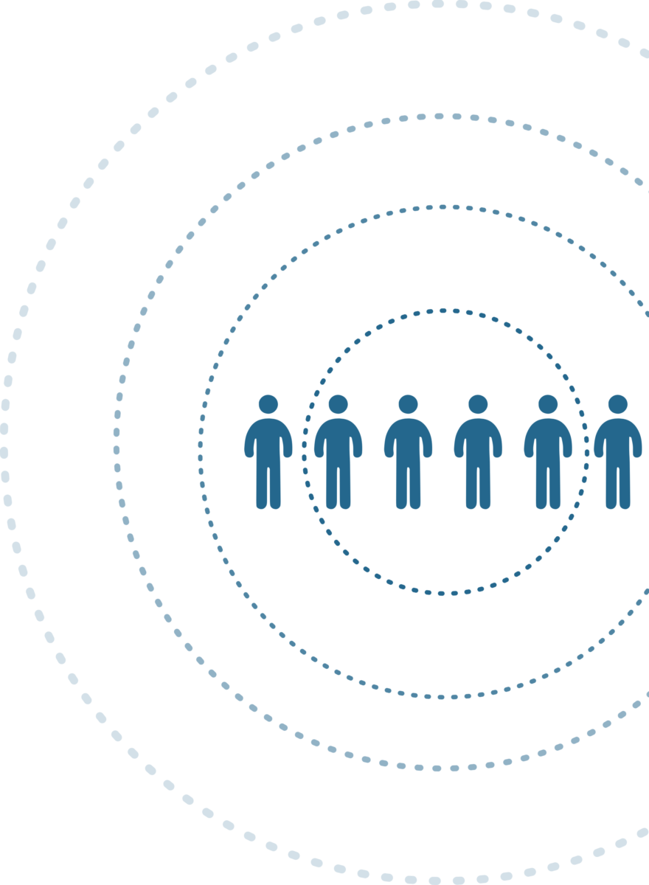
36
About the 2024 ‘Corporate Reputation of Pharma’ data
Brazilian Patient Groups’ Views of Pharma
Brazil-specific findings from the most-recent edition (that of 2023/24) of PatientView’s annual report, ‘The Corporate Reputation of Pharma—from a Patient Perspective’.
121 Brazilian patient groups describe what they think of pharma.
They identify the strategic interventions they wish pharma to implement, to improve patient-group relations in Brazil.
Few studies explore the opinions of patient groups worldwide on whether pharma companies meet the expectations of patients and patient groups (and, if not, how might the industry, and individual pharma companies, improve).
PatientView’s annual ‘Corporate Reputation of Pharma’ survey gives health campaigners and patient-advocacy groups (PAGs) an opportunity to comment on, and assess, the pharma industry’s performance.
Each year, the results of the survey help support company efforts to strengthen their ties with patient groups.

Slide 20
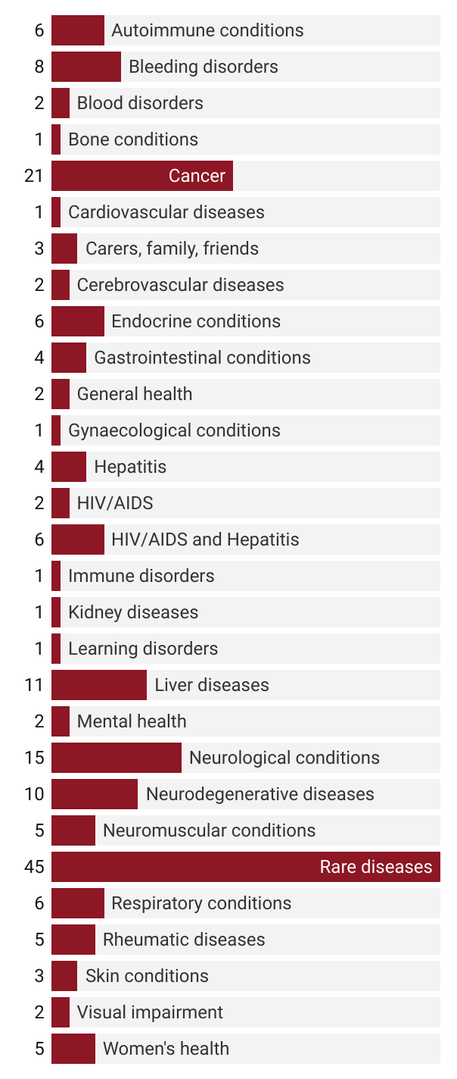
38
Methodology behind ‘Corporate Reputation’
Speciality profile of the 131 Brazilian patient groups which responded to the online 2023 ‘Corporate Reputation of Pharma’ survey
Percentage of total
PatientView’s annual online ‘Corporate Reputation of Pharma’ survey, conducted between November-February, measures various aspects of pharma’s performance at corporate reputation—always from a patient perspective.
During the course of the survey’s 13-year history, pharma companies and patient groups alike have contributed to the design of the survey questionnaire. The survey questionnaire is divided into two sections, to assess …
Firstly, the performance of the pharma industry (as a whole) at activities important to patients and patient groups.
Secondly, Brazilian patient-group advice on how pharma can improve its corporate reputation—from the perspective of patients.

Slide 21
40
Executive Summary: Brazilian patient groups on pharma
The reputation of pharma among patient groups in Brazil is high—with 80% of Brazilian patient groups stating that the pharma industry has an “Excellent” or “Good” corporate reputation.
That reputation has been maintained over several years.
In 2023, the majority of Brazilian patient groups believe pharma “Excellent” or “Good” at most of the activities of importance to Brazilian patients and patient groups:
  Patient centricity.
  Patient information.
  Patient safety.
  Innovation.
  Providing products of benefit to patients.
  Integrity.
  Patient-group relations.
However, in 2023, the majority of Brazilian patient groups do not believe pharma to be “Excellent” or “Good” at the following five activities of importance to Brazilian patients and patient groups:
  Transparency.
  Providing services ‘beyond the pill’.
  Having fair pricing policies.
  Engaging patients in R&D.
  Improving patient access to medicines.

Slide 22
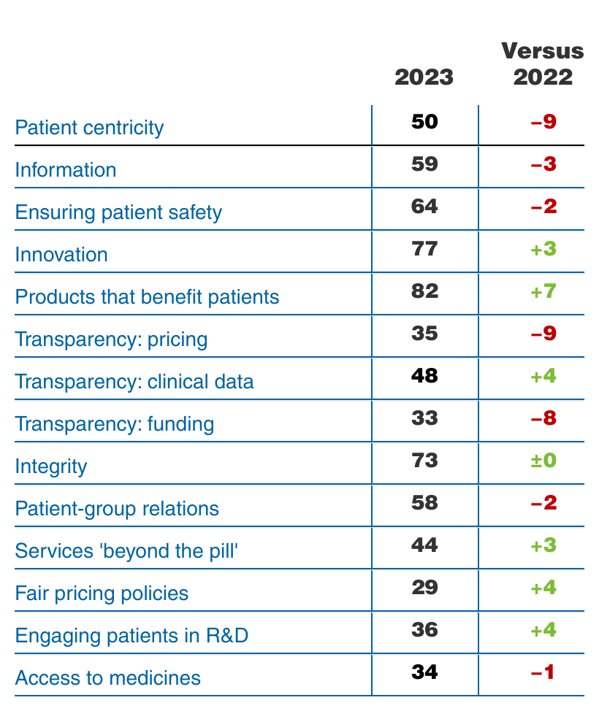
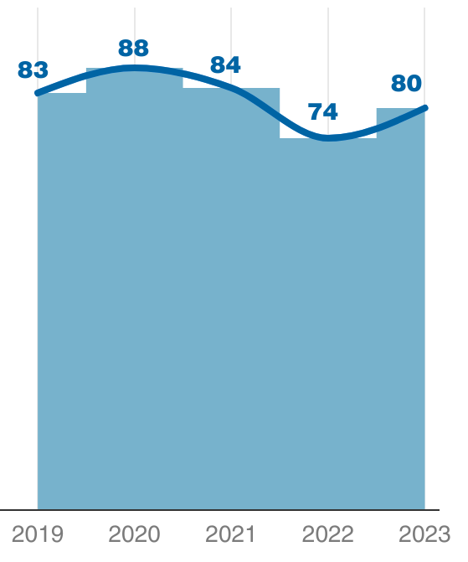
42
Industry-wide results
Percentage of respondent Brazilian patient groups stating that the pharma industry was “Excellent” or “Good” at activities of importance to Brazilian patients and patient groups, 2023 v. 2022
The corporate reputation of the pharma industry,
2019-2023—according to Brazilian patient groups
% of respondent Brazilian patient groups, per year, stating “Excellent” or “Good”
Number of respondent Brazilian patient groups, 2023, N = 121

Slide 23
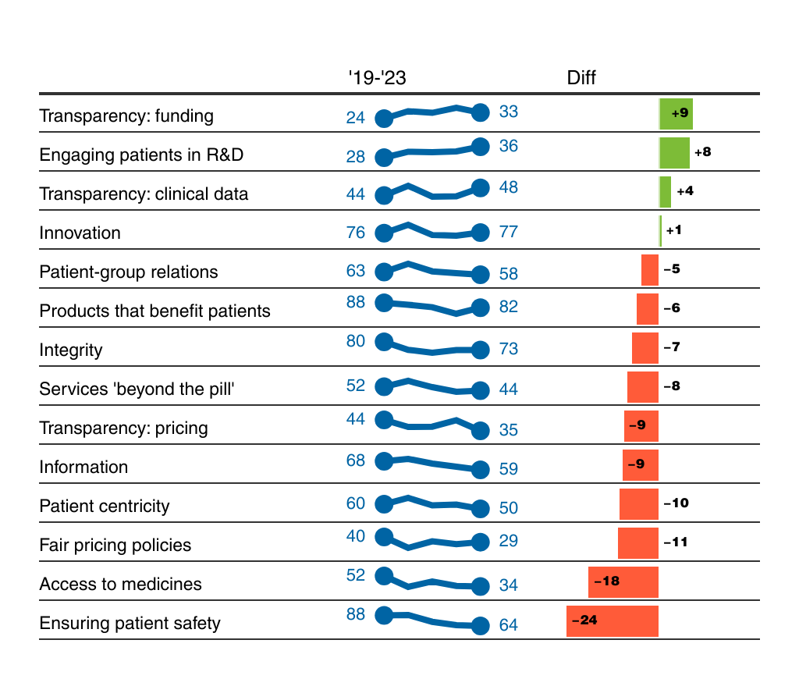
44
Industry-wide results
Percentage of respondent Brazilian patient groups stating that the pharma industry was “Excellent” or “Good” at activities of importance to Brazilian patients and patient groups, 2019-2023
Brazilian patient groups have rated the pharma industry highly for corporate reputation over the past five years.
However, Brazilian patient groups mark the pharma industry down significantly for its performance at some activities of importance to Brazilian patients and patient groups
—notably …
• patient safety,
• access to medicines, and
• fair pricing policies.

Slide 24
46
‘Moving Forward’:
Strategic priorities for pharma
Brazilian patient groups highlight the indicators of corporate reputation at which the pharma industry most needs to improve in Brazil
Thematic analysis of commentaries
A thematic analysis of Brazilian patient groups’ qualitative feedback, advising on strategic direction for pharma in Brazil
—ranked and defined.
121 Brazilian patient groups provide 630 comments on how pharma might improve in Brazil.
19% of the commentaries from respondent Brazilian patient groups emphasise that the priority for pharma companies in Brazil should be patient access to medicines.
Indicator of corporate reputation | % of total comments
Access to medicines | 19%
Patient-group relations | 14%
Transparency | 14%
Patient information | 12%
Engaging patient in R&D | 9%
Services ‘beyond the pill’ | 8%
Products of benefit to patients | 7%
Patient centricity | 6%
Integrity | 6%
Patient safety | 4%

Slide 25
48
‘Moving Forward’:
Strategic priorities for pharma
Brazilian patient groups propose key strategic changes that they believe pharma in Brazil needs to make to improve corporate reputation
Thematic analysis of commentaries
What Brazilian patient groups mean by: “improve patient access to medicine” | % of total comments
Improve pathways, and the patient experience | 21%
Improve the speed/quality of HTA, and approvals | 18%
Enable affordable pricing | 18%
Ensure greater equity in access to medicines (overview) | 15%
Build local links | 13%
Address inequities of access | 10%
Help gather evidence to support equity of access | 3%
Avoid taking any anti-competitive actions | 3%
As mentioned on the previous slide, 19% of the commentaries from respondent Brazilian patient groups emphasise that the priority for pharma companies in Brazil should be patient access to medicines.
Of these 19%: 21% recommend that pharma focus on improving pathways, and the patient experience.

Slide 26
50
‘Moving Forward’:
Strategic priorities for pharma
Enable affordable pricing
• Focus on affordability throughout the development and commercialisation of a treatment, to help make treatments more affordable for healthcare systems, insurers, or individual patients.
• Be open to drug-pricing reforms, and to innovative pricing models requested by patient groups and healthcare systems.
Improve pathways, and the patient experience
• Work with healthcare systems at national, and local, levels—to augment the overall experience that patients (and caregivers) have in reliably accessing, and using, treatment.
• Help healthcare systems to develop, and to improve, treatment pathways (and identify critical gaps in local delivery).
Ensure greater equity in access to medicines (overview)
• Take equitable access into account in management decisions about pipeline, portfolio, and brand lifecycle—to help healthcare systems achieve their aims to improve patient equity of access to treatments.
Improve the speed/quality of HTA, and approvals
Retain high standards of pharmacovigilance, while accelerating HTA, insurer, payor, and regulatory approvals.
Helping to keep patient views and priorities at the centre of the approvals process. For example:
• Balancing company investment in local clinical research, and in market-access solutions, between high-, medium-, and low-income countries.
• Demonstrating to regulators how patients have been involved in R&D,
and in commercialisation decisions—from identifying priority unmet needs,
onwards.
• Involving all stakeholders early on in the research process, with the aim of enabling speedier approvals.
Build local links
• Extend relationships to more countries outside of the company’s existing most-profitable markets. For example, enable faster acceptance of a treatment in a country, by involving that country at the research stage.
• Deepen local links within existing core markets (for example, leverage local relationships), to help quantify and address inequity of access to treatments between local geographic areas.
◆

Slide 27
52
‘Moving Forward’:
Strategic priorities for pharma
Avoid taking any anti-competitive actions
• Attempt to increase the scale, and the quality, of appropriate
collaboration between companies, and also between the industry and
other stakeholders—both for the collective interest of patients.
• Evaluate commercial and competitive decisions on the basis of any perceived harm that they may have on patients. For example, perceptions of:
• Hindering new entrants by ‘evergreening’ patents.
• Withholding licenses unreasonably.
• Focusing brand extensions on protecting brands, and on price rises—rather than on addressing genuine unmet needs.
• Withdrawing less-profitable treatments, despite their being depended upon by communities of patients—particularly if no immediate alternative treatment is available to those patients.
• Halting clinical research for commercial (rather than clinical) reasons.
• Focusing treatment launches onto the most-profitable markets—thereby denying access by many other countries.
Address inequities of access
• Globally, take action to rebalance access to treatments between high-, medium-, and low-income countries.
• Within countries, identify actions to support patients’ access to treatments (including, for example, financial Patient Assistance Programs).
Help gather evidence to support equity of access
Work with patient groups (and other healthcare stakeholders) to help prove the scale of health inequities for specific diseases. For example:
• Support registries (and other sources), to demonstrate the scale of the divergence between disease prevalence and treatment delivery.
• Identify the gaps between, on the one hand, clinical pathways,
guidelines, and standards, and, on the other hand, what local patients
actually receive.
• Map the regional/local patterns of access within a country.
• Identify the personal factors that contribute to patients’ inequity of
treatment access—such as age, ethnicity, gender, location, and socioeconomic status.

Slide 28
54
‘Moving Forward’:
Strategic priorities for pharma
“Programas de acesso precoce e compassivo: implementar programas de acesso precoce para fornecer terapias inovadoras a pacientes que não têm opções de tratamento disponíveis. Isso demonstra um compromisso em atender às necessidades urgentes dos pacientes.”
—Regional cystic-fibrosis patient group
“Entrar em acordo com o governo na questão de preços, praticando valores iguais aos que apresentam em outros países, para que se possa ter acesso por esse meio, já que não é possível de outra forma.”
—National rare-disease patient group
“Temos conhecimento de pacientes que fazem uso de medicação e os programas oferecidos. A farmacêutica não tem nenhum suporte efetivo ao paciente. Do que adianta tomar uma medicação de milhares de reais e não ser acompanhado com serviços de saúde regulamente, e morrer afogado em secreção?”
—Local neurological-conditions patient group

Slide 29
Please do not hesitate to contact us, should you have further questions, or wish to access the report
report @ patient-view.com
Contact details:
Patientview Ltd
Registered office: One Fleet Place, London, EC4M 7WS, UK
Tel: +44-(0)1547-520-965
Email: report @ patient-view.com
Registered in England Number: 3944382
Data Protection Registration Number: Z7133076
VAT Registration Number: GB-760-985-885
COPYRIGHT © 2024 PATIENTVIEW LTD
ALL RIGHTS RESERVED
THIS BOOKLET IS THE PROPERTY OF PATIENTVIEW AND NO PART MAY BE REPRODUCED WITHOUT PERMISSION OR PASSED ON TO ANY THIRD PARTY WITHOUT THE PERMISSION OF PATIENTVIEW

